Slide 1
Introduction to Microeconomics

Slide 2
Lecture 12 Supply, Demand, and Government Policies

Slide 3
Supply, Demand, and Government Policies
Price Ceilings
Price ceiling is a legal maximum on the price at which a good can be sold.
Suppose, the American Association of Ice-Cream Eaters complains that the equilibrium price is too high for everyone to enjoy a cone a day (their recommended diet).
So, the Association lobbies the government to pass laws that alter the market outcome by directly controlling the price of an ice-cream cone.

Slide 4
Supply, Demand, and Government Policies
Price Ceilings
If the Ice-Cream Eaters are successful in their lobbying, the government imposes a legal maximum on the price at which ice cream can be sold.
Because the price is not allowed to rise above this level, the legislated maximum is called a price ceiling.

Slide 5
Supply, Demand, and Government Policies
How Price Ceilings affect Market Outcomes
When the government imposes a price ceiling on the market for ice cream, two outcomes are possible.
In panel (a) of Figure 1, the government imposes a price ceiling of $4 per cone.
In this case, because the price that balances supply and demand ($3) is below the ceiling, the price ceiling is not binding.

Slide 6
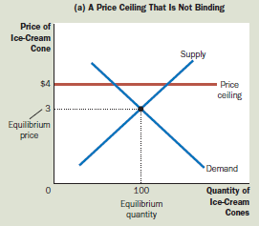
Supply, Demand, and Government Policies
How Price Ceilings affect Market Outcomes
Market forces naturally move the economy to the equilibrium, and the price ceiling has no effect on the price or the quantity sold.

Slide 7
Supply, Demand, and Government Policies
How Price Ceilings affect Market Outcomes
In Panel (b) of Figure 1, the government imposes a price ceiling of $2 per cone.
Because the equilibrium price of $3 is above the price ceiling, the ceiling is a binding constraint on the market.
The forces of supply and demand tend to move the price toward the equilibrium price, but when the market price hits the ceiling, it can, by law, rise no further.

Slide 8
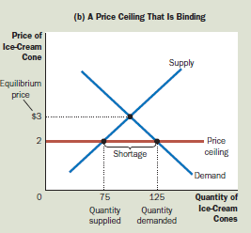
Supply, Demand, and Government Policies
How Price Ceilings affect Market Outcomes

Slide 9
Supply, Demand, and Government Policies
How Price Ceilings affect Market Outcomes
Thus, the market price equals the price ceiling.
At this price, the quantity of ice cream demanded (125 cones in the figure) exceeds the quantity supplied (75 cones).
There is a shortage of ice cream: 50 people who want to buy ice cream at the going price are unable to do so.

Slide 10
Supply, Demand, and Government Policies
How Price Ceilings affect Market Outcomes
When a shortage of ice cream develops because of this price ceiling, some mechanism for rationing ice cream will naturally develop.
The mechanism could be long lines: Buyers who are willing to arrive early and wait in line get a cone, but those unwilling to wait do not.
Alternatively, sellers could ration ice cream according to their own personal biases, selling it only to friends, relatives, or members of their own racial or ethnic group.

Slide 11
Supply, Demand, and Government Policies
How Price Ceilings affect Market Outcomes
Notice that even though the price ceiling was motivated by a desire to help buyers of ice cream, not all buyers benefit from the policy.
The rationing mechanisms that develop under price ceilings are rarely desirable. Long lines are inefficient because they waste buyers’ time. Discrimination according to seller bias is both inefficient and potentially unfair.
By contrast, the rationing mechanism in a free, competitive market is both efficient and impersonal.

Slide 12
Supply, Demand, and Government Policies
Price Floors
Price floor is a legal minimum on the price at which a good can be sold.
Suppose, the National Organization of Ice-Cream Makers complains that the market equilibrium is too low and is depressing the incomes of its members.
So, the Organization lobbies the government to pass laws that alter the market outcome by directly controlling the price of an ice-cream cone.

Slide 13
Supply, Demand, and Government Policies
Price Floors
If the Ice-Cream sellers are successful in their lobbying, the government imposes a legal minimum on the price.
Because the price cannot fall below this level, the legislated minimum is called a price floor.
So, price floors, like price ceilings, are an attempt by the government to maintain prices at other than equilibrium levels.
Whereas a price ceiling places a legal maximum on prices, a price floor places a legal minimum.

Slide 14
Supply, Demand, and Government Policies
How Price Floors affect Market Outcomes
When the government imposes a price floor on the ice-cream market, two outcomes are possible.
If the government imposes a price floor of $2 per cone when the equilibrium price is $3, we obtain the outcome in panel (a) of Figure 4.
In this case, because the equilibrium price is above the floor, the price floor is not binding.

Slide 15
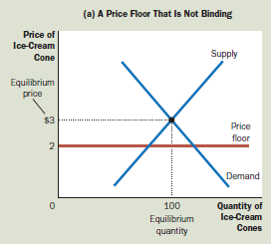
Supply, Demand, and Government Policies
How Price Floors affect Market Outcomes
Market forces naturally move the economy to the equilibrium, and the price floor has no effect.

Slide 16
Supply, Demand, and Government Policies
How Price Floors affect Market Outcomes
Market forces naturally move the economy to the equilibrium, and the price floor has no effect.
Panel (b) of Figure 4 shows what happens when the government imposes a price floor of $4 per cone.
In this case, because the equilibrium price of $3 is below the floor, the price floor is a binding constraint on the market.

Slide 17
Supply, Demand, and Government Policies
How Price Floors affect Market Outcomes
The forces of supply and demand tend to move the price toward the equilibrium price, but when the market price hits the floor, it can fall no further.
The market price equals the price floor. At this floor, the quantity of ice cream supplied (120 cones) exceeds the quantity demanded (80 cones).
Some people who want to sell ice cream at the going price are unable to. Thus, a binding price floor causes a surplus.

Slide 18
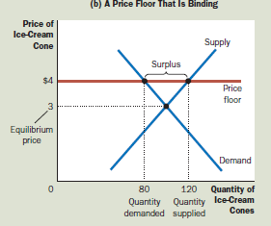
Supply, Demand, and Government Policies
How Price Floors affect Market Outcomes
Just as the shortages resulting from price ceilings can lead to undesirable rationing mechanisms, so can the surpluses resulting from price floors.

Slide 19
Supply, Demand, and Government Policies
How Price Floors affect Market Outcomes
In the case of a price floor, some sellers are unable to sell all they want at the market price.
The sellers who appeal to the personal biases of the buyers, perhaps due to racial or familial ties, are better able to sell their goods than those who do not.
By contrast, in a free market, the price serves as the rationing mechanism, and sellers can sell all they want at the equilibrium price.

Slide 20
Supply, Demand, and Government Policies
Evaluating Price Controls
One of the Ten Principles of Economics is that markets are usually a good way to organize economic activity.
This principle explains why economists usually oppose price ceilings and price floors.
Prices have the crucial job of balancing supply and demand and, thereby, coordinating economic activity.

Slide 21
Supply, Demand, and Government Policies
Evaluating Price Controls
Another one of the Ten Principles of Economics is that governments can sometimes improve market outcomes.
Indeed, policymakers are led to control prices because they view the market’s outcome as unfair.
Price controls are often aimed at helping the poor. For instance, rent-control laws try to make housing affordable for everyone, and minimum-wage laws try to help people escape poverty.

Slide 22
Supply, Demand, and Government Policies
Evaluating Price Controls
Yet price controls often hurt those they are trying to help.
Rent control may keep rents low, but it also discourages landlords from maintaining their buildings and makes housing hard to find.
Minimum-wage laws may raise the incomes of some workers, but they also cause other workers to be unemployed.

Slide 23
Supply, Demand, and Government Policies
Evaluating Price Controls
Helping those in need can be accomplished in ways other than controlling prices.
For instance, the government can make housing more affordable by paying a fraction of the rent for poor families (rent subsidies).
Unlike rent control, such rent subsidies do not reduce the quantity of housing supplied and, therefore, do not lead to housing shortages.

Slide 24
Supply, Demand, and Government Policies
Evaluating Price Controls
Similarly, wage subsidies raise the living standards of the working poor without discouraging firms from hiring them.
An example of a wage subsidy is the earned income tax credit, a government program that supplements the incomes of low-wage workers.
Although these alternative policies are often better than price controls, they are not perfect. Rent and wage subsidies cost the government money and, therefore, require higher taxes. And taxation has costs of its own.

Slide 25
Readings
N. G. Mankiw- Principles of Microeconomics, 5th Edition, Chapter – 6.

Slide 26


Slide 27
Thank You

